Slide 1

Exploratory Data Analysis
Virtual Internship
3-17-2021

Slide 2

Agenda
Executive Summary
Problem Statement
Approach
EDA
EDA Summary
Recommendations

Slide 3
Executive Summary
XYZ is a private firm in US. Due to remarkable growth in the Cab Industry in last few years and multiple key players in the market, it is planning for an investment in Cab industry and as per their Go-to-Market(G2M) strategy they want to understand the market before taking final decision.
Objective:
To analyse, recommend and identify which company is performing better and is a better investment opportunity for the company XYZ.
The Analysis and recommendations are based on the below factors:
Data Analysis and understanding
Profit and number of rides
Find more profitable car company to invest in
Recommendation information for invesment

Slide 4
Data Exploration
Data Set Used
Formed a Master Data by combining below datasets.
1. Cab_Data
2. City
3. Customer_ID
4. Transaction_ID
Time Frame
2016 to 2018
Total Observations
359,392

Slide 5
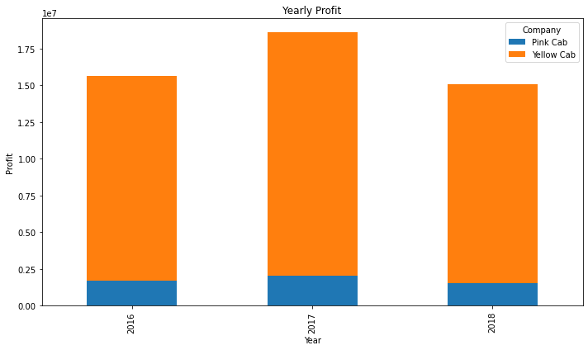
Yearly Profit

Slide 6
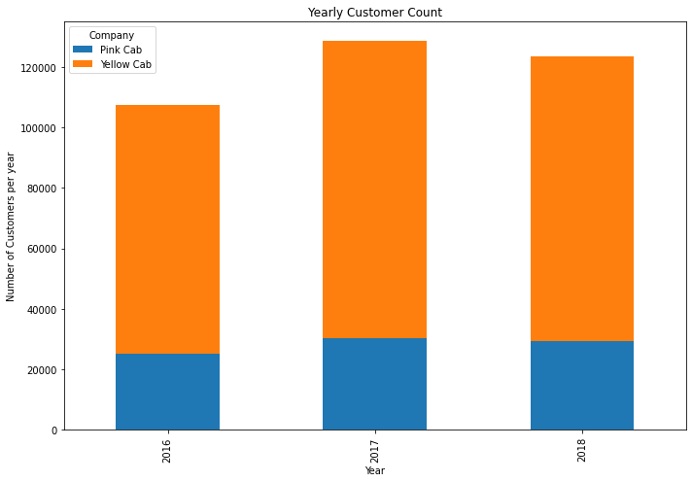
Total Customers

Slide 7
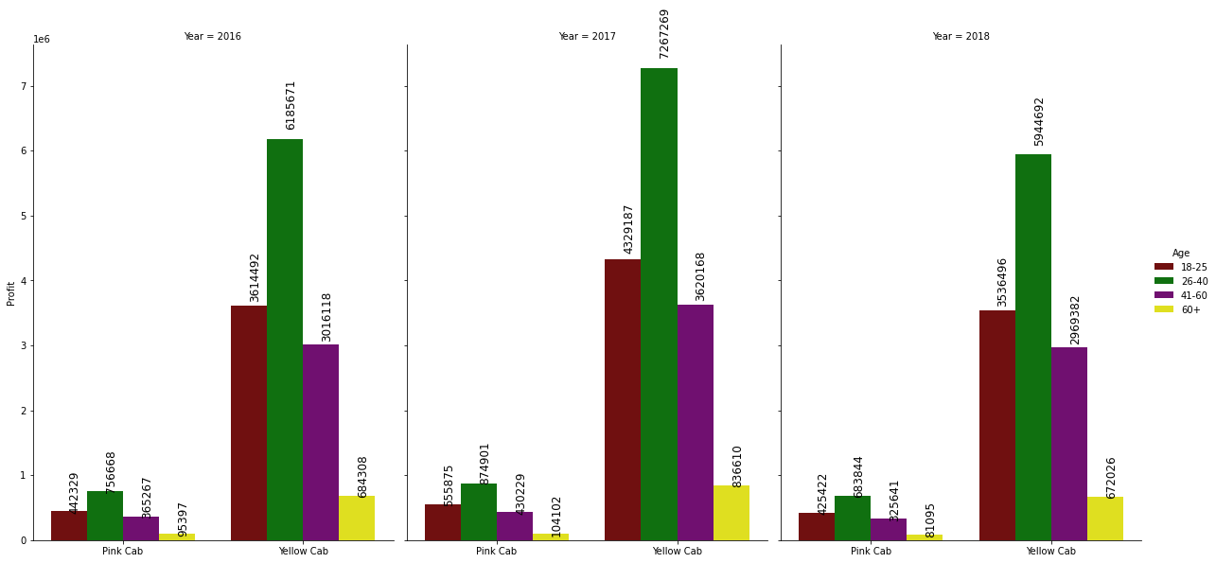
Profit by Age Group

Slide 8
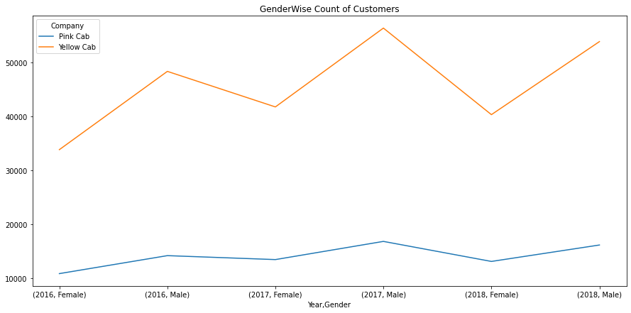
No of Customer on Gender Basis

Slide 9
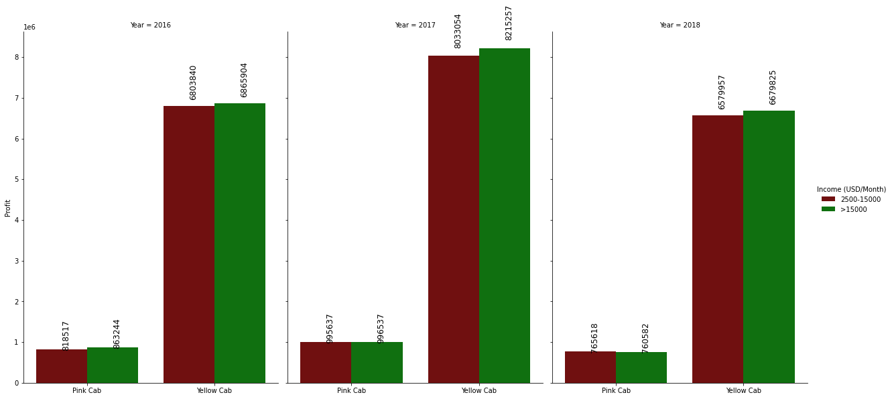
Income Wise Profit

Slide 10
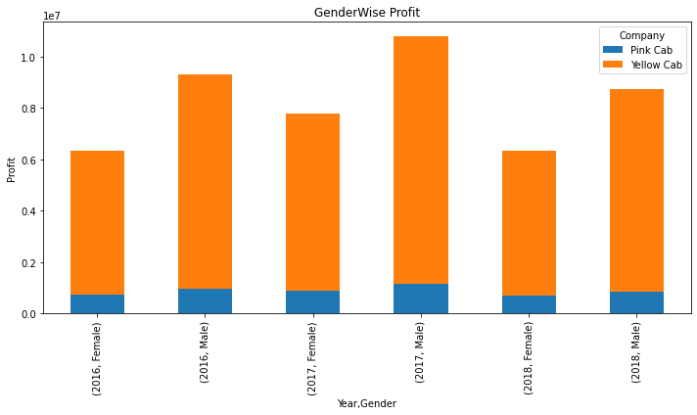
Gender wise Profit

Slide 11
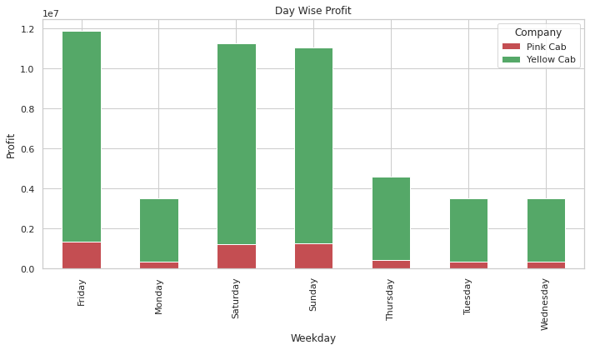
Day Wise Profit

Slide 12
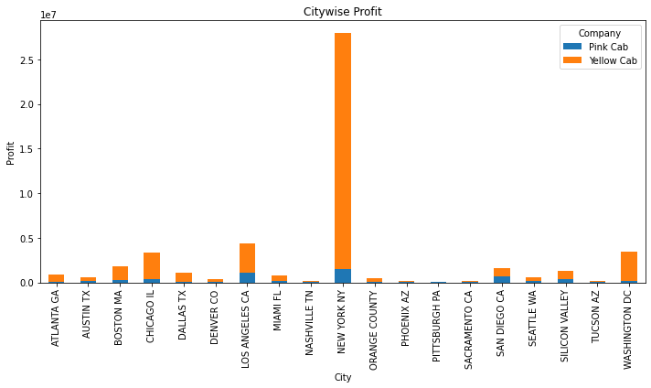
City wise Profit

Slide 13
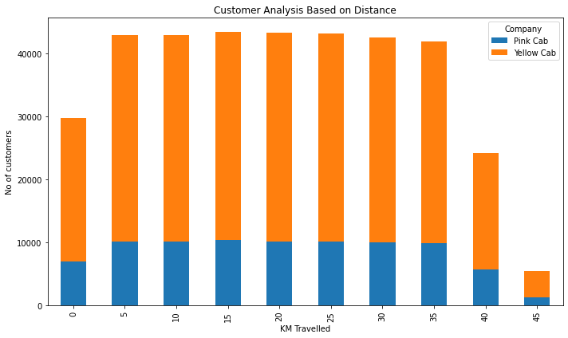
Customer Analysis Based on Distance

Slide 14
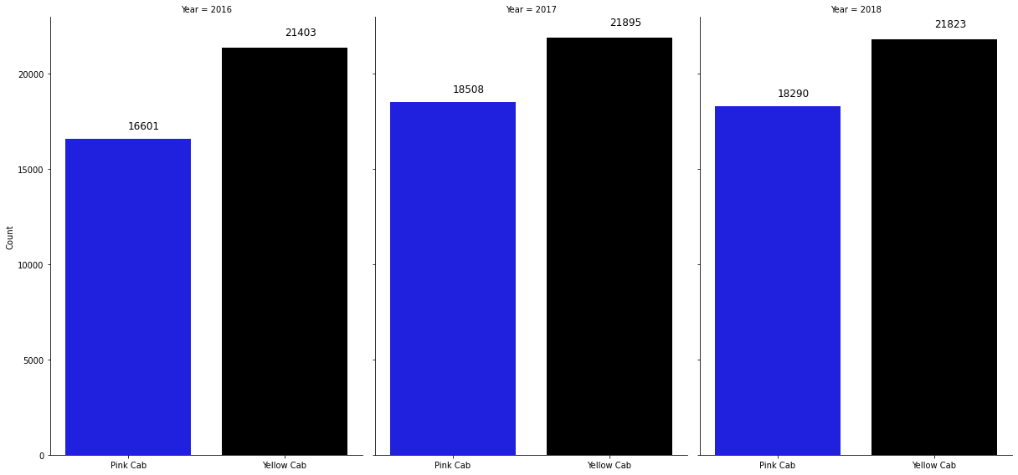
Customer Retention 0 to 5 rides

Slide 15
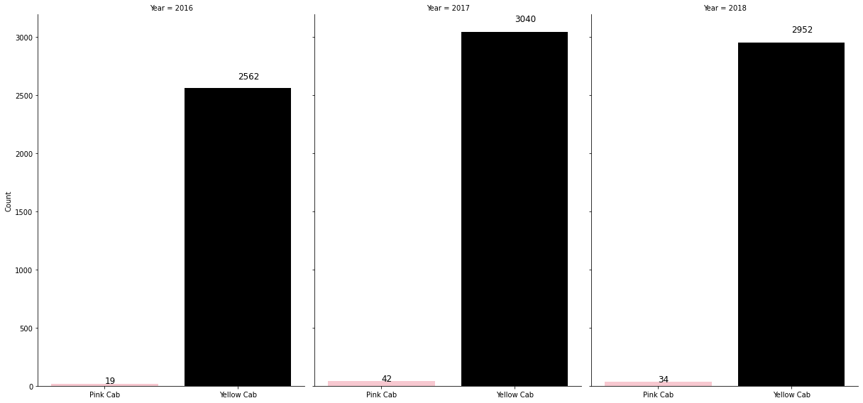
Customer Retention 6 to 10 rides

Slide 16
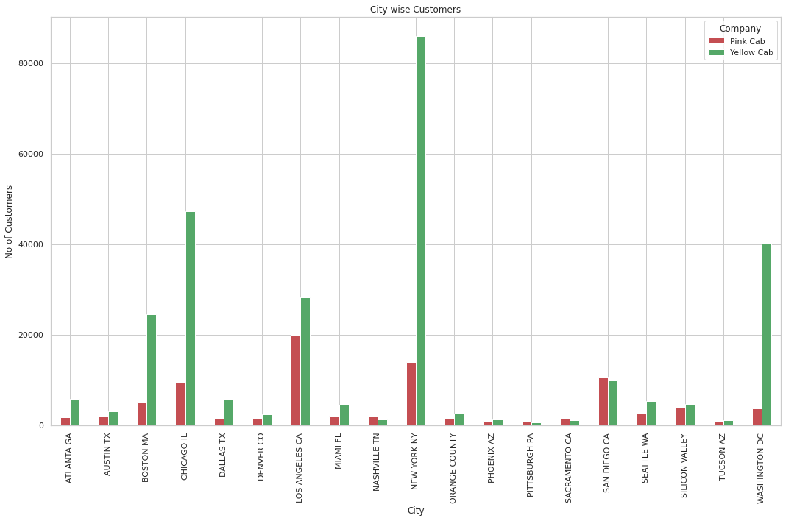
City Wise Customers

Slide 17
Recommendations
According to the Analysis, Company XYZ can invest in Yellow Cab, The reasons as follows:
Profit: In Yearly Wise and City Wise, The profit of yellow can is higher than pink Cab
Customer Count: No of Customers are higher in Yellow cab where as very less in pink cab.
Gender Wise Profit: Yellow cab in double more than the pink cab on the basis of Gender wise profit(Both male and female)
Distance Travelled: The customers used yellow cab travelled more distance than pink Cab.
From the above analysis, I would like to recommend company XYZ to invest in Yellow Cab for better company growth and profit.

Slide 18
Thank You

